Slide 1
Project Final Presentation
ISA 441 - Group D
Drew Arnold, Alexander Bean, Tyler Rozmus

Slide 2
Presentation Outline
Design Process - Phase I
Defining the business problem
Showing the two-tier development platform
Project charter
Design Process - Phase II
WSB chart
Gantt chart
Design Process - Phase III
Use case diagram
Use case forms
Systems sequence diagrams
Activity diagrams
State chart diagrams
Domain class diagram
IV. Design Process - Phase IV
Use case dialog
Form storyboard
Menu hierarchy
Prototype ER diagram
Prototype SQL create code & entries
V. Design Process - Phase V
Triggers & audit tables
Access database connectivity
VI. Bubble.io Site Demo
Site Demo Recording

Slide 3
Defining The Business Problem
The challenge for the business in this scenario is to effectively manage the delivery and transportation of finished goods from the production facility to the distribution hub while adhering to federal and state regulations. The challenge is maximizing the use of each truck while ensuring that the cargo weight and storage capacity of the trucks are not exceeded. Additionally, to guarantee that the right goods are delivered to the appropriate location, precise tracking of the quantity, weight, and contents of each box is necessary. To guarantee customer satisfaction and uphold the company's reputation, any discrepancies in the shipment must be found and resolved right away. Finally, in order to avoid fines or legal problems, compliance with rules governing driver working hours and transit time must be ensured.

Slide 4
Two-Tier Platform for Development
The two-tier platform for development typically consists of a client-side application and a server-side application.
The client-side application runs on the end-user's device, such as a desktop or mobile device, and is responsible for handling the user interface and user interactions and is delivered to the user's device via a web browser or mobile app.
The server-side application is responsible for handling the business logic, data processing, and database management and it typically runs on a remote server and communicates with the client-side application.
In this architecture, the client-side application is responsible for presenting the data to the user and handling user interactions, while the server-side application handles the data processing and storage. This approach provides several benefits, such as improved scalability, better security, and easier maintenance and updates, as the server-side application can be updated independently of the client-side application.

Slide 5
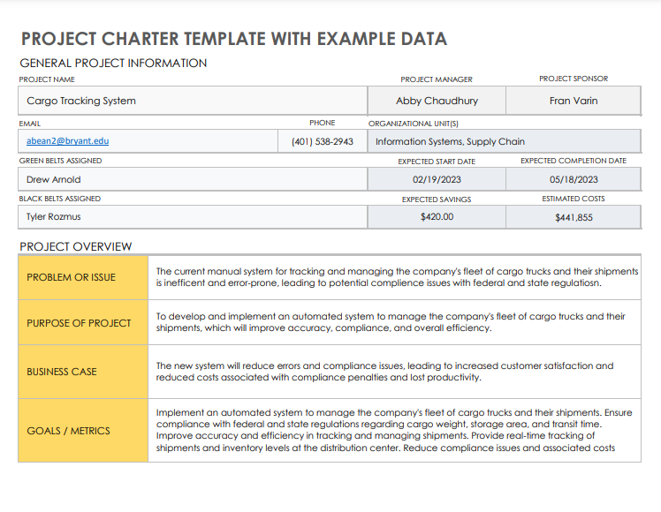
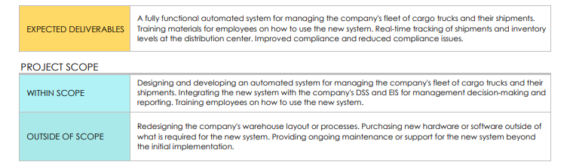
Project
Charter

Slide 6
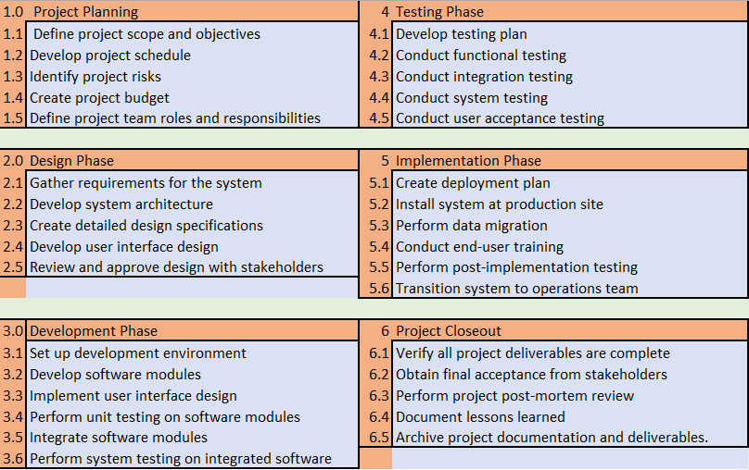
WSB Chart

Slide 7
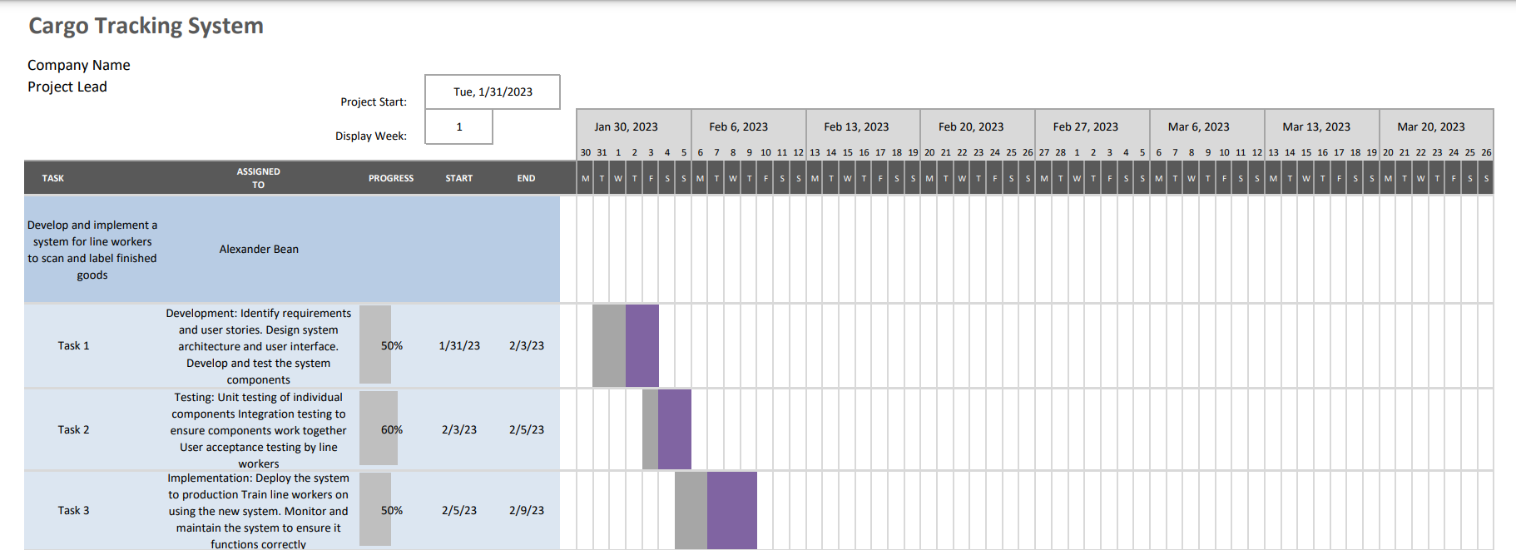
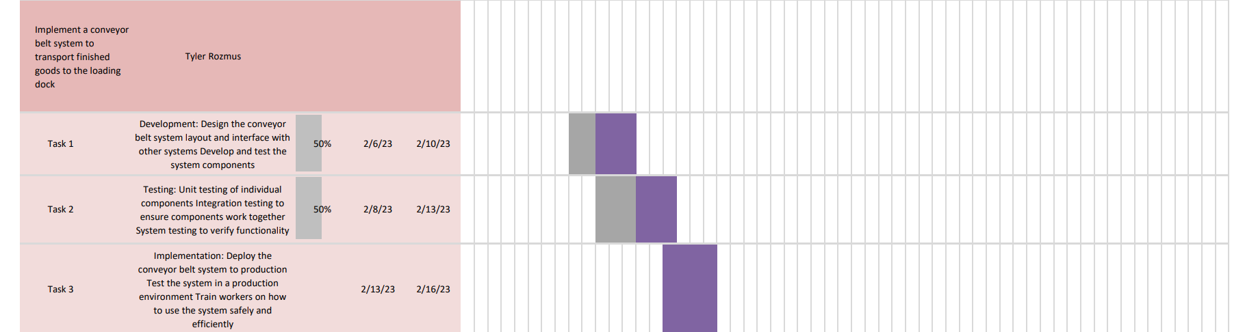
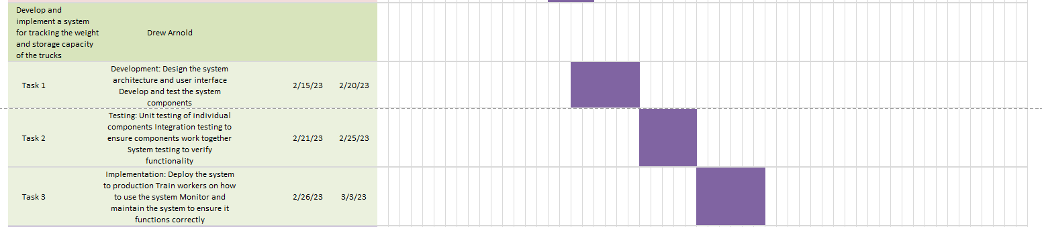
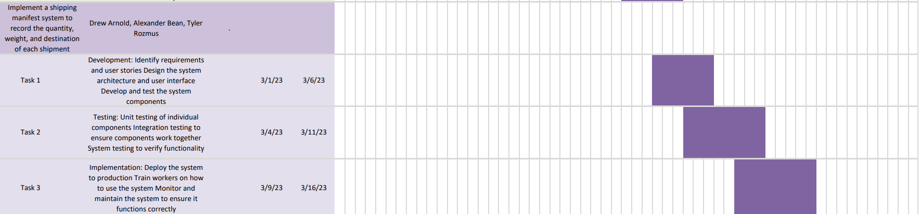
Gantt
Chart

Slide 8
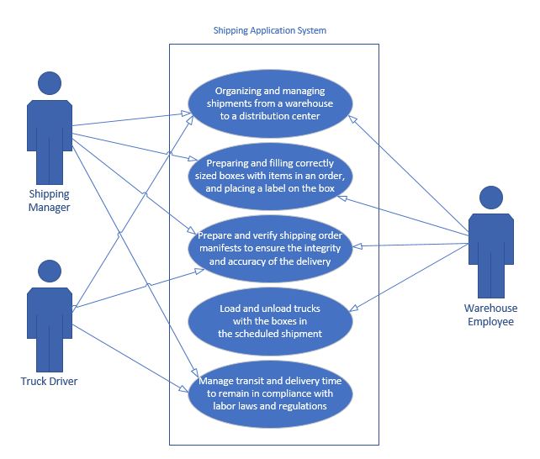
Use Case Diagram

Slide 9
Use Case Form #1
Use Case: Preparation of the Shipment
Actors: Manager & Warehouse Employees
Description:
The manager has prepared a shipment order with a manifest of the ordered items. The shipment order is viewable by warehouse employees for them to prepare the shipment for delivery. The warehouse employees use the application to prepare and record information of boxes for the shipment. The boxes are loaded onto the truck and scanned to track the shipment process.
Preconditions:
An order has been requested for the manager to prepare
The scanner system is operational
Flow of Events:
The manager receives a request to prepare a shipment
The manager produces an order manifest to be accessible by the warehouse employees
The warehouse employees begin to prepare the order according to the items requested
The warehouse employees print a label for the box, with a scannable barcode, a label number, the contents of the box, and the box’s size
The box is placed on a conveyor belt to be loaded, where the label will be scanned into the truck assigned to the order, until the entire order is loaded
Postconditions:
The box information on the label is recorded in the application database
The shipment status is updated in the application database to show it has been loaded.
The boxes are all assigned to the order and truck within the database, properly linking the entire order together in the application
Exceptions:
If the truck is not available right away, the order will still be prepared for efficiency
If the labels do not scan, the printed label number can be manually entered into the app
If the shipment weight or capacity exceeds one truck, then either another truck will be assigned to fulfill the order, or the assigned truck will make multiple deliveries
Reason for Use Case:
This use case form displays the functionality of our application’s core. It demonstrates how the warehouse employees use the application to keep track of inventory in every box. It also demonstrates how the system keeps track of order statuses through the labels and conveyor belt scanning system, which is a key feature.

Slide 10
Use Case Form #2
Use Case: Delivery of the Shipment
Actors: Manager & Truck Driver
Description:
The truck driver has multiple deliveries to make in a short period of time, and the manager needs to coordinate with the truck driver to manage the delivery
Preconditions:
The truck driver has not driven for close to or more than the legal time limit for work
The shipment does not exceed the weight or capacity of the single truck
There are no delays in the preparation of the shipment at the warehouse
Flow of Events:
The manager receives a request to prepare a shipment
The manager confirms how long the delivery should take and contacts a truck driver who is able to perform the delivery without exceeding the time restriction.
If not already at the warehouse, the truck driver arrives at the warehouse for the order
When the order is loaded and secured, the truck driver drives to the distribution center
The truck driver arrives at the distribution center and the order is fulfilled
Postconditions:
The shipment is updated as delivered, specifically the date of delivery and total transit time. It is recorded to ensure the company is in line with regulations for driving time
The contents of the order are moved outside of the shipment system, as they have been delivered
Exceptions:
If the truck driver will not be able to deliver due to time restrictions, another driver will be called. If no other drivers can perform the delivery, it will be delayed
If the contents of the order exceed the weight or capacity of the single truck, one of two results will be determined by the manager. Either another driver finishes the delivery or the initial driver will make multiple trips to fulfill the delivery.
Reason for Use Case:
This use case form displays the other end of our application, which directly ties to the deliveries. It is less involved compared to the previous case, but it details how the process of product deliveries work with our system. It also demonstrates how the labor laws for the truck drivers impact shipments in the network. The necessary information related to these laws are tracked within the application’s database.

Slide 11
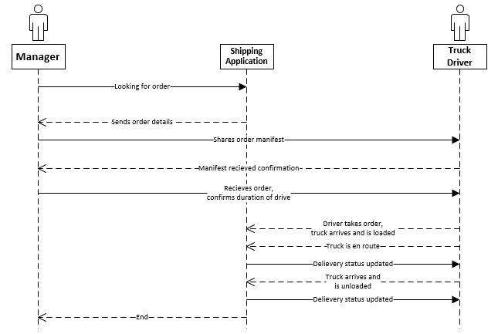
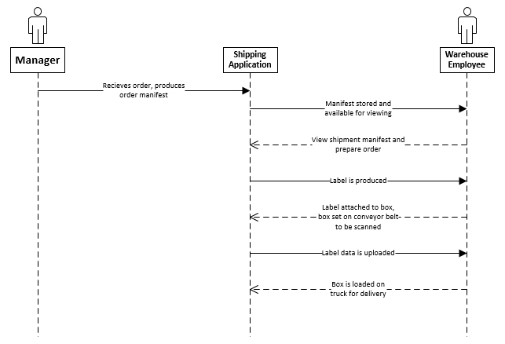
Systems Sequence Diagram

Slide 12
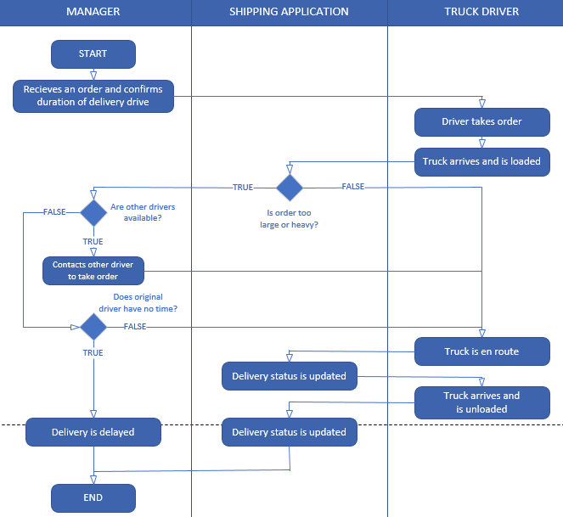
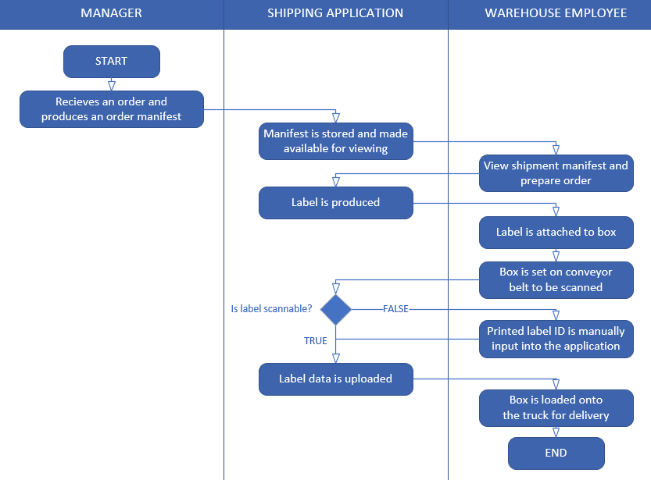
Activity Diagrams
Preparation of the Shipment
Delivery of the Shipment

Slide 13
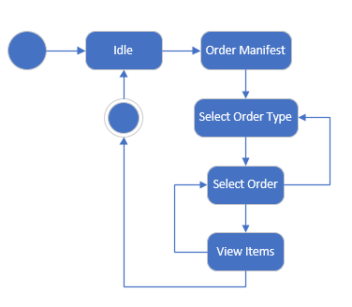
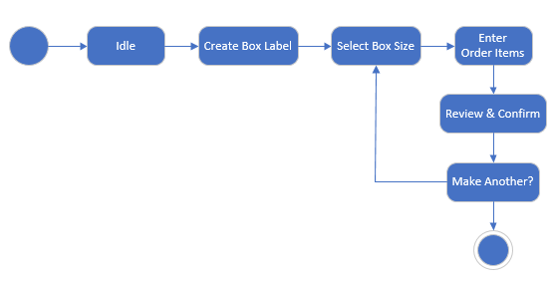
Activity Diagrams
Creating a Label for the Box
Searching for Previous Orders

Slide 14
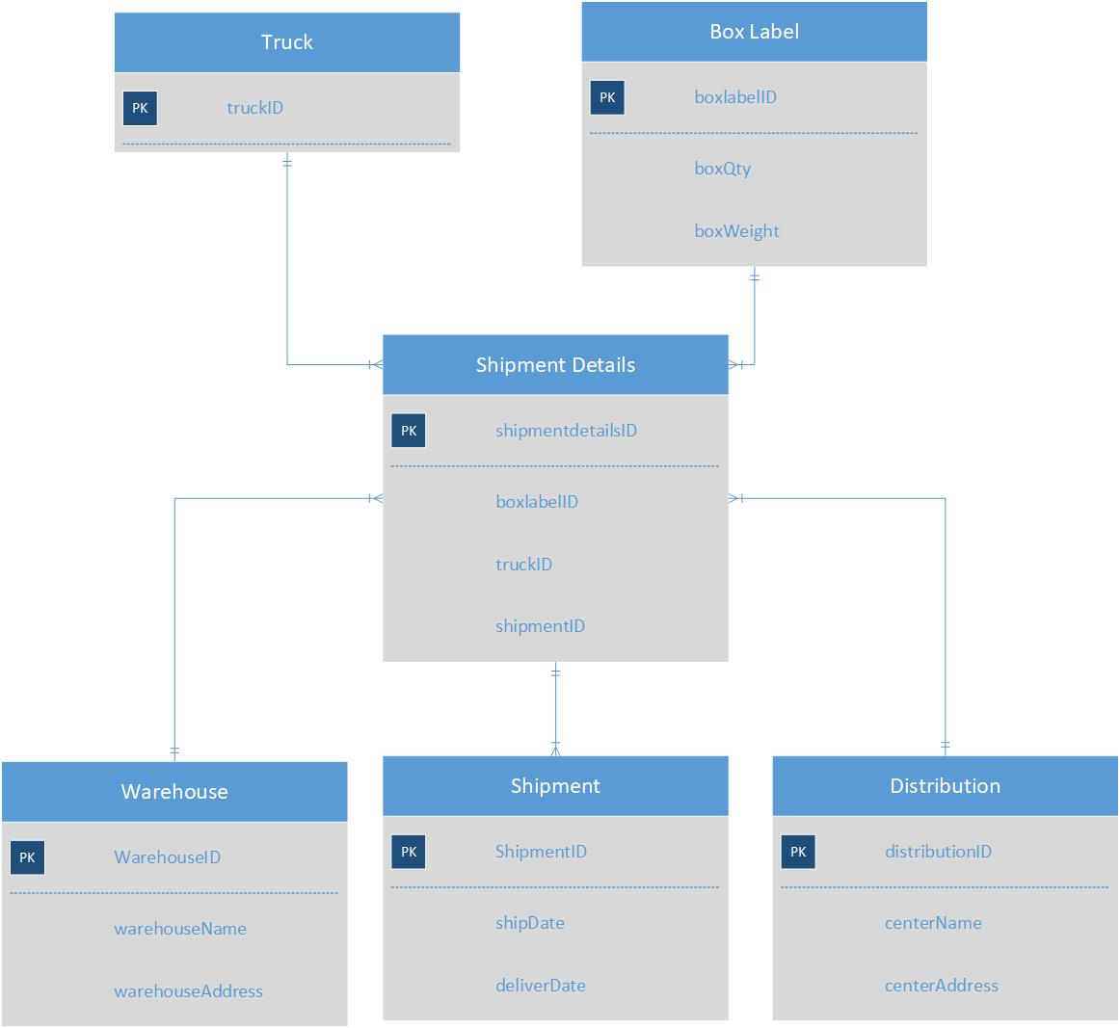
Domain
Class
Diagram

Slide 15
Use Case Example Dialog
Use Case 1: Preparation of the Shipment
User: Enters the label creation window
System: Displays a form for the user to select a box size from a drop down menu
User: Selects box size and closes drop down
System: Displays a form below the previous for the user to enter item information and quantity
User: Enters all the item information for the box and clicks next
System: Displays a review form with all of the previous information
User: Confirms and select print label
System: Label prints, and the user is prompted to enter another box or to exit
User: Attaches label to box and places it on conveyor belt
System: Detects boxes moving on conveyor belt. If a label is not able to be scanned, the system stops the belt and prompts the user to enter the label’s written ID
User: Enters the label information into the system
System: Updates the box’s shipping status and resumes conveyor belt and scanning

Slide 16
Use Case Example Dialog
Use Case 2: Delivery of the Shipment
User: Moves boxes to be scanned by the system. Step directly follows the end of Use Case 1
System: If the total weight of the scanned order exceeds that of highway regulations, the conveyor belt stops and the user is prompted to change trucks or pause order
User: Enters new truck information
System: Updates truck number on box that flagged weight and uses new truck number for the remaining boxes.
User: Ends loading process by choosing option in system.
User: On the other end, at the distribution center, the unloading process begins when the truck arrives. Begins unloading the truck.
System: Updates shipment status for boxes unloaded. If a label is not able to be scanned, the system stops the belt and prompts the user to enter the label’s written ID
User: Enters the label information into the system
System: Updates the box’s shipping status, and resumes conveyor belt and scanning

Slide 17
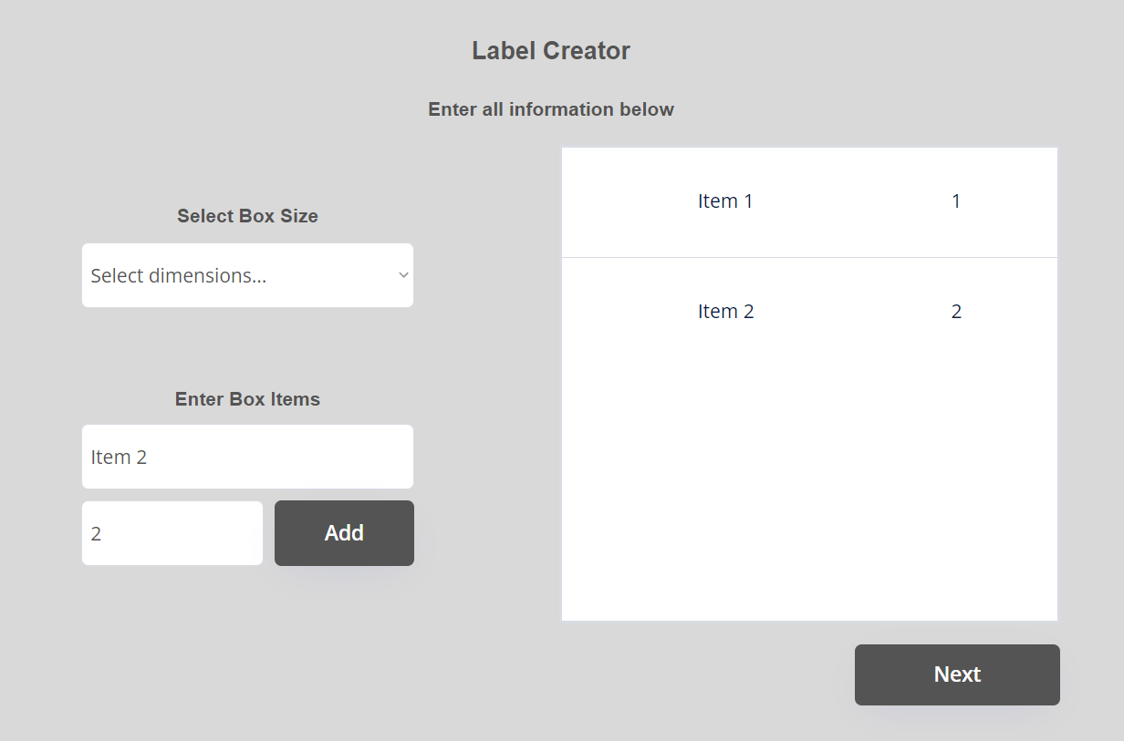
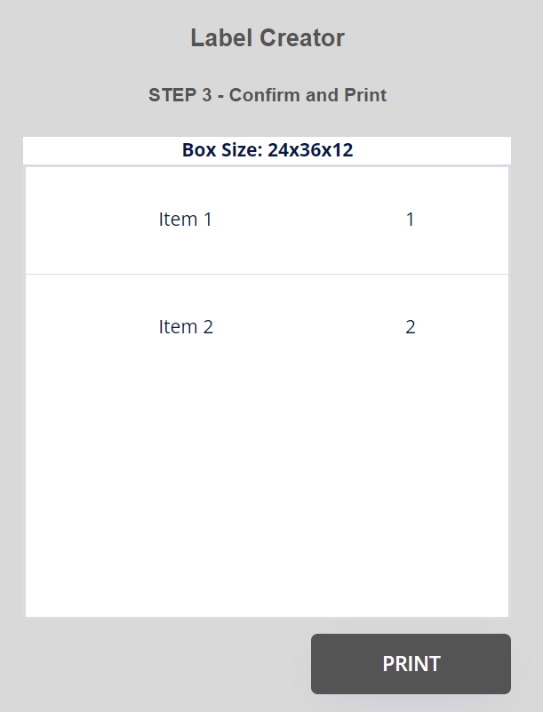
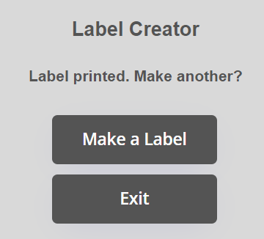
Storyboard Form - Label Creation
Entering the box information
Reviewing the information entered
Repeat or end cycle
END

Slide 18
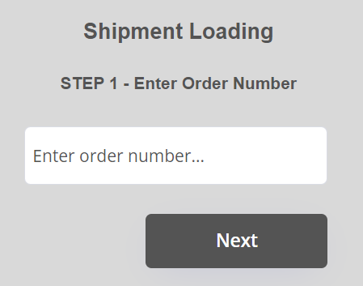
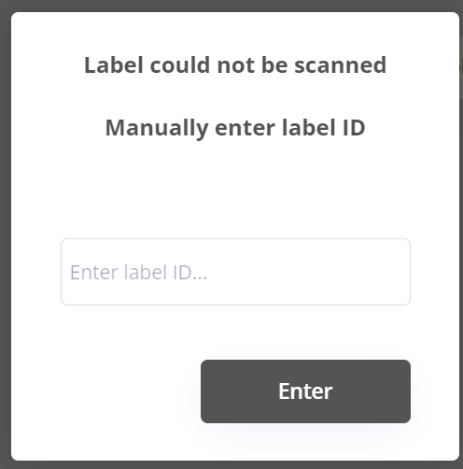
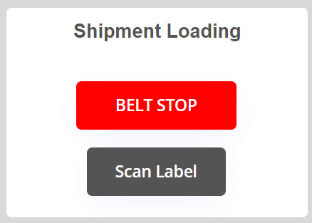
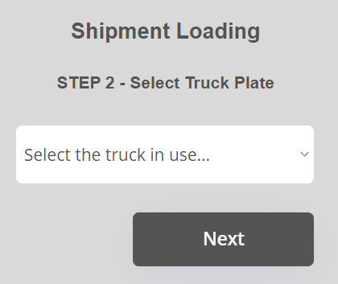
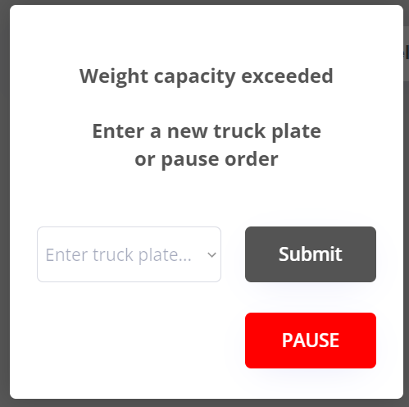
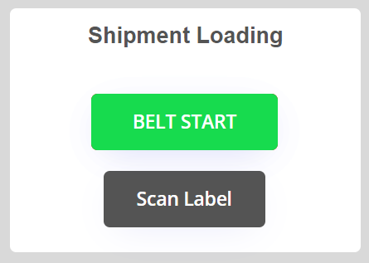
Storyboard Form - Loading a Truck
This pop-up would appear if a label fails to scan on the conveyor belt. The belt pauses and the user must manually enter the label ID.
If valid and raises no flags, pop-up closes and belt resumes
If a label scanned would bring the truck over the legal weight for that shipment, the belt pauses and this pop-up opens
If a new truck is select, the pop-up closes and belt resumes
If pause is selected, user is returned to the main page
Confirming order # and
truck being loaded
Conveyor belt before and after
being initiated by the toggle
END

Slide 19
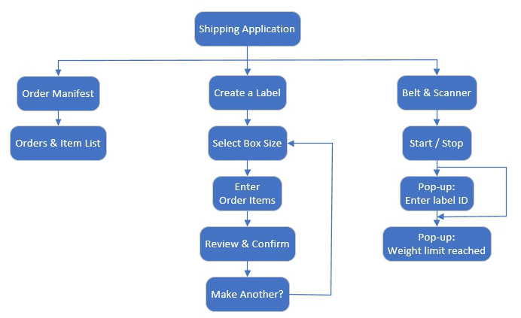
Menu
Hierarchy
Diagram

Slide 20
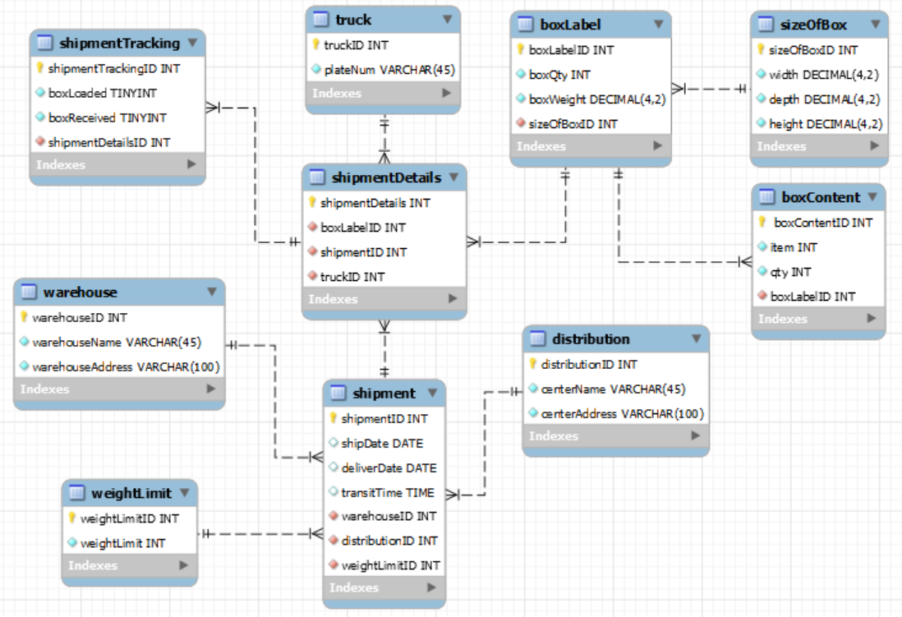
Database
ER Diagram

Slide 21
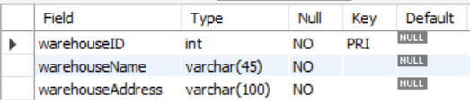
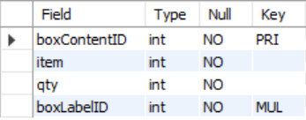
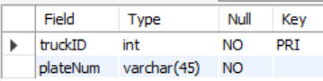
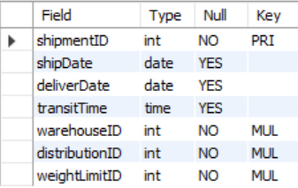
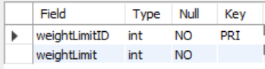
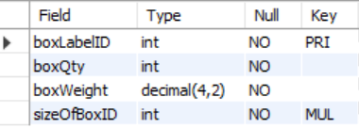
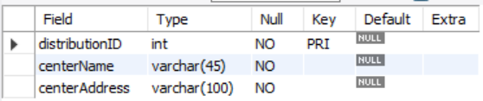
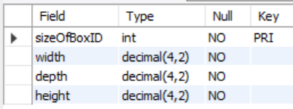
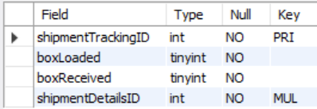
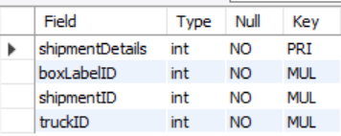
SQL Tables for Prototype

Slide 22
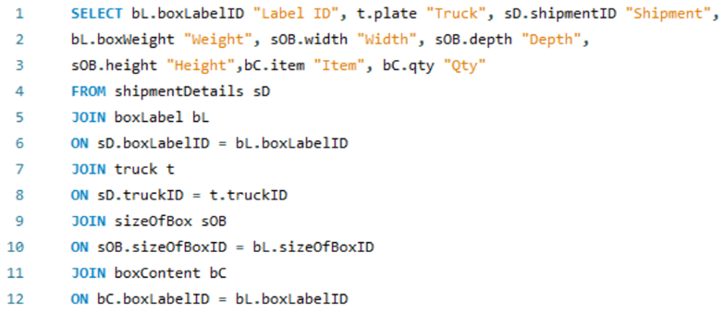
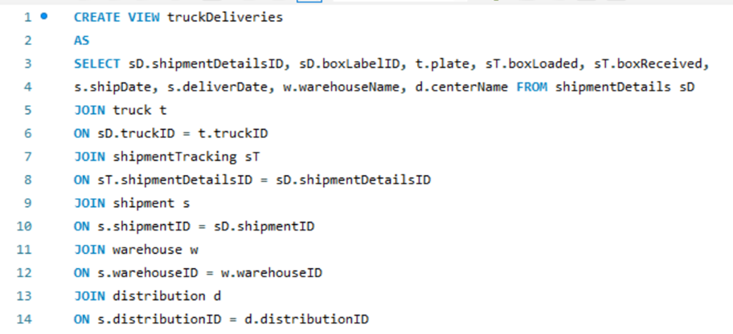
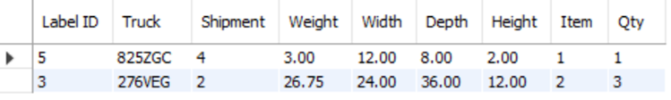
Views & Joins
Takes any box, and finds its dimensions and weight, what and how many items are in the box, and what truck and shipment it belongs to
Allows truck driver employees to see the truck in use, the boxes in the shipment, the pick up and drop off locations, and the delivery status

Slide 23
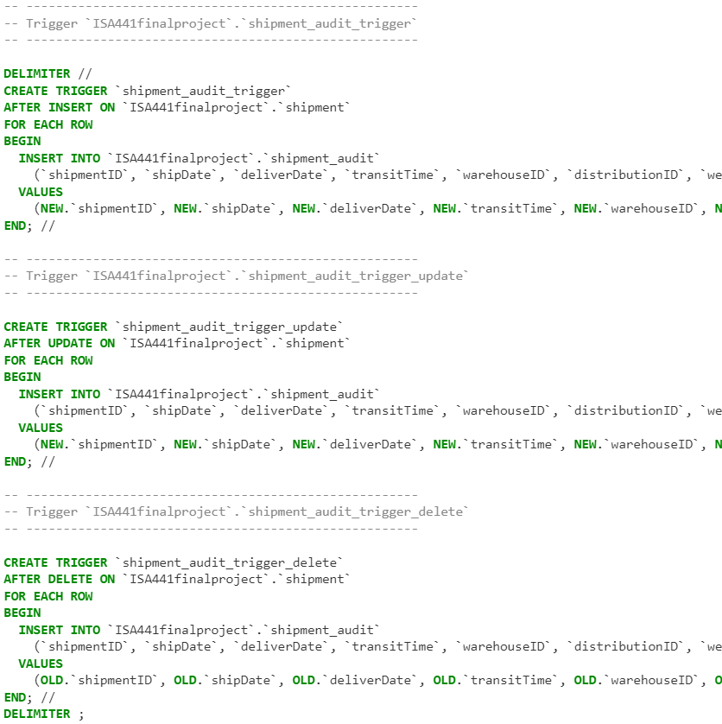
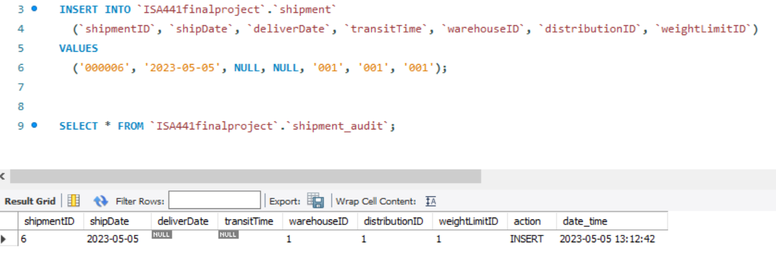
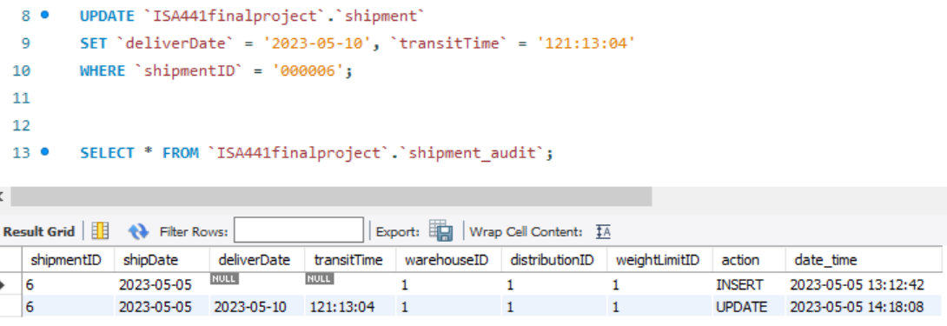
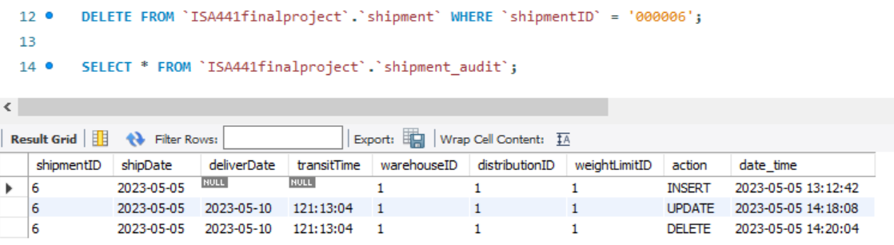
SQL Triggers
Creating the Triggers
Testing the Triggers

Slide 24
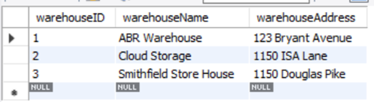
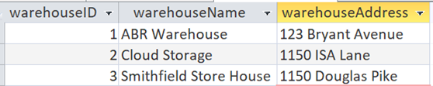
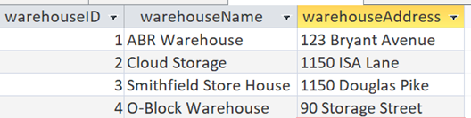
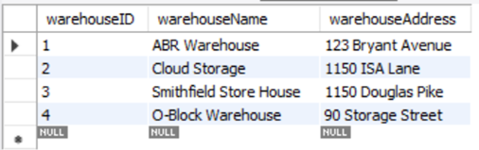
Access Connection Test
Before editing database in Access
Database before edits
Added new warehouse in Access
New warehouse displays in Access

Slide 25

Bubble.io
Website
Demo

Slide 26
Thank You!
Any Questions?

